Slide 1
Database Systems
PLSQL – TRIGGERS & CURSORS

Slide 2
Triggers
Triggers in PL/SQL are special types of stored procedures that are automatically executed or fired in response to certain events on a particular table or view.
The code to be fired can be customized.

Slide 3
Types of Trigger Levels
Row-level Triggers:
Fired once for each row affected by a triggering statement (e.g., INSERT, UPDATE, DELETE).
Includes BEFORE and AFTER triggers.
Statement-level Triggers:
Fired once for each triggering statement, regardless of the number of rows affected.
Applies to the entire statement, not individual rows.
Useful for actions that don't depend on specific row data.

Slide 4
Trigger Timing - BEFORE Triggers
Executed before the triggering statement.
Can be used to modify the data before it is actually written to the database.
Commonly used for validation or data manipulation.
CREATE OR REPLACE TRIGGER before_insert_trigger
BEFORE INSERT ON your_table
FOR EACH ROW
BEGIN
-- Trigger logic here
END;

Slide 5
Trigger Timing - AFTER Triggers
Executed after the triggering statement.
Useful for actions that should occur after data changes have been committed.
Commonly used for auditing or logging changes.
CREATE OR REPLACE TRIGGER after_update_trigger
AFTER UPDATE ON your_table
FOR EACH ROW
BEGIN
-- Trigger logic here
END;

Slide 6
Trigger Events
INSERT Trigger:
Fired when a new row is inserted into the table.
UPDATE Trigger:
Fired when one or more columns of an existing row are updated.
DELETE Trigger:
Fired when a row is deleted from the table.
Instead of Triggers:
Used for views to replace the default DML behavior.
Enables custom actions when INSERT, UPDATE, or DELETE operations are attempted on a view.

Slide 7
Trigger Components
Trigger Body:
Contains the PL/SQL code that is executed when the trigger fires.
Triggering Event:
Specifies the event that causes the trigger to fire (e.g., INSERT, UPDATE, DELETE).
Triggering Statement:
Specifies the SQL statement that causes the trigger to fire.

Slide 8
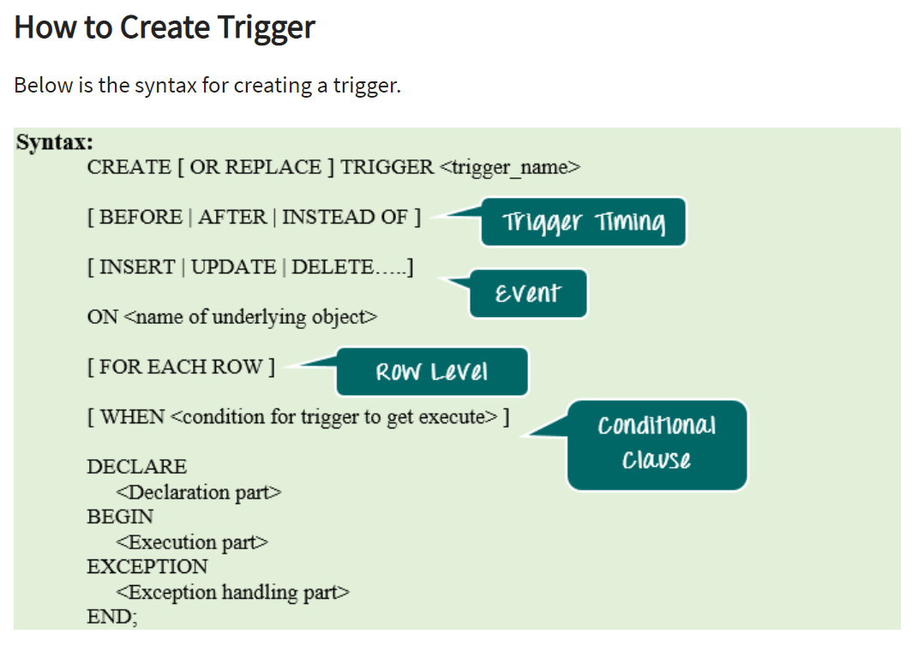

Slide 9
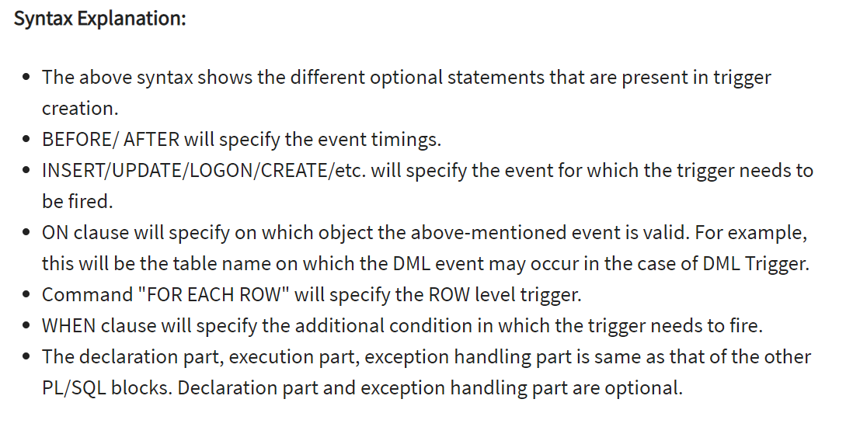

Slide 10
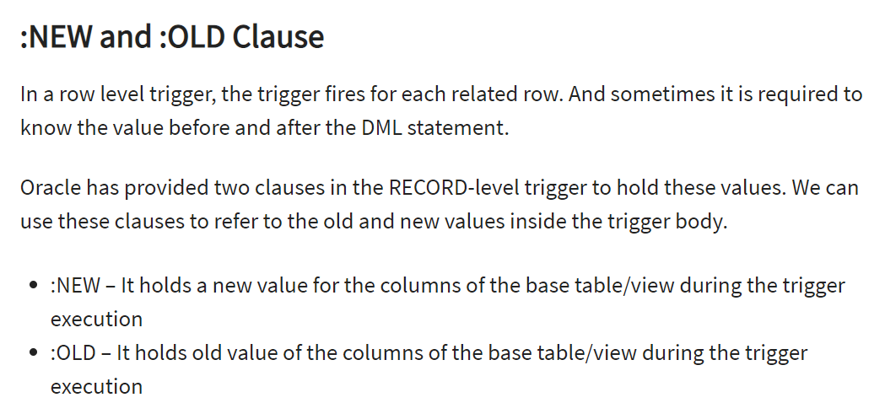

Slide 11
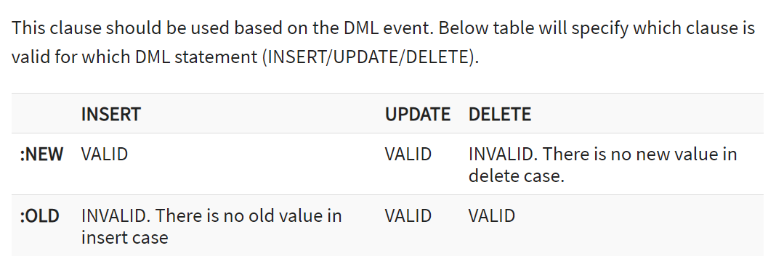

Slide 12
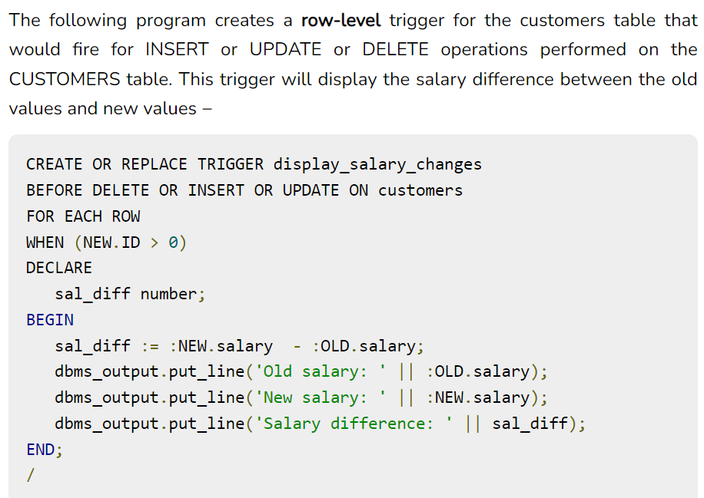

Slide 13
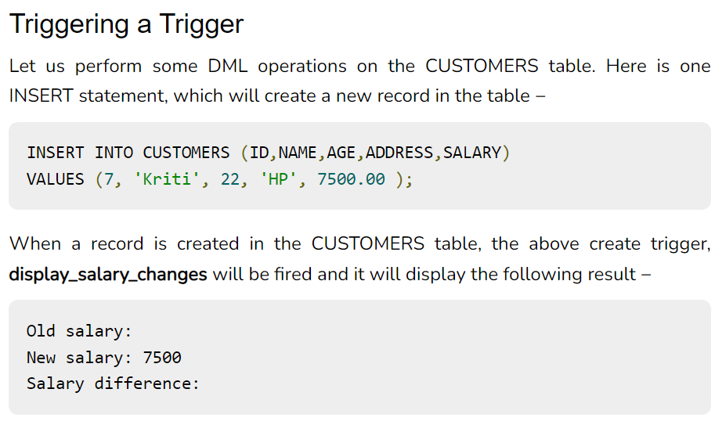

Slide 14
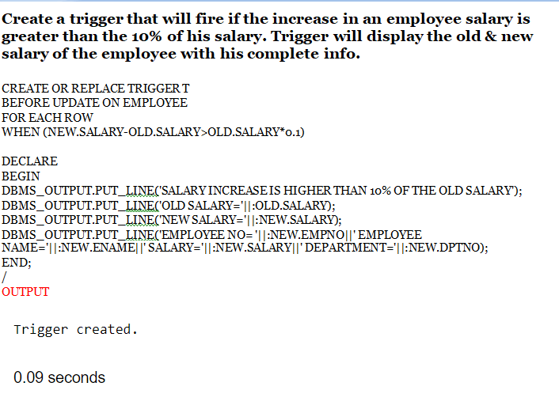

Slide 15
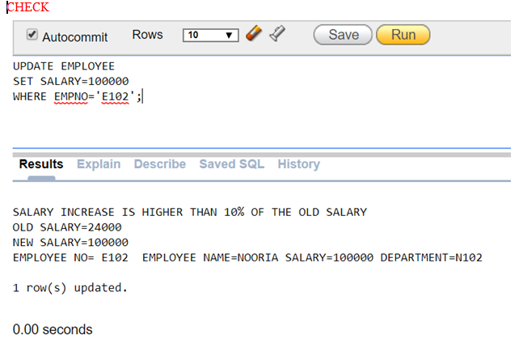

Slide 16
Cursors
A cursor is a temporary work area created in the system memory when a SQL statement is executed.
Allocated by Database Server at the time of performing DML operations by user.
A cursor contains information on a SELECT statement and the rows of data accessed by it.
Can hold information of more than one row.
One row at a time can be accessed.

Slide 17
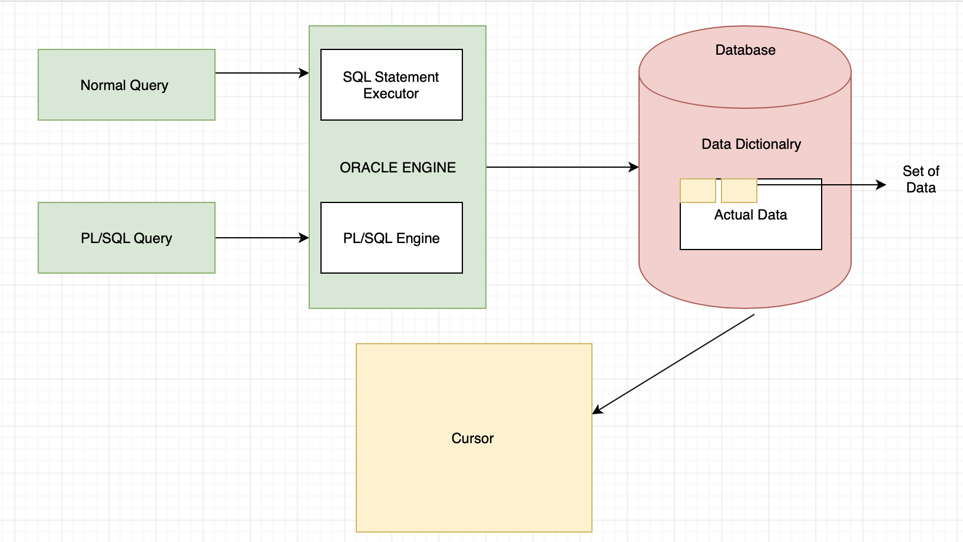

Slide 18
PL/SQL cursor is a mechanism by which
“ you can NAME that work area
and
manipulate the information within it”

Slide 19
Types
Implicit Cursors
Explicit Cursors

Slide 20
Implicit Cursors
Automatically created by Oracle when a SQL statement is executed.
Used for single-row queries.
Whenever a DML operation like SELECT,UPDATE,INSERT happens on a row Oracle creates the cursor internally.
SELECT on a single row is an implicit cursor.
User cannot specify a name to Implicit Cursor.

Slide 21
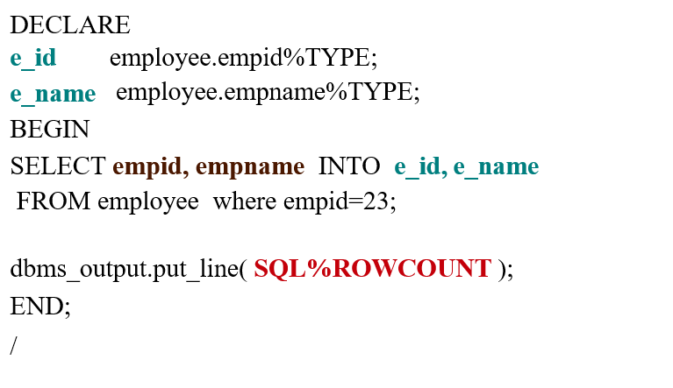
Single Row Implicit Cursors

Slide 22
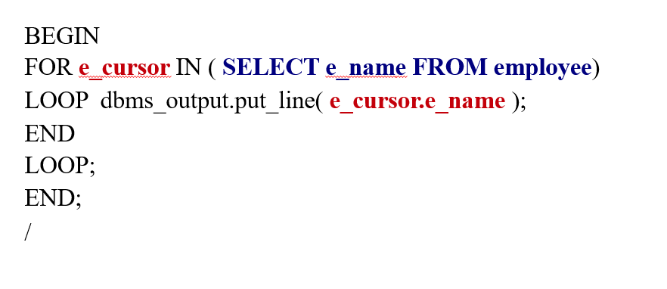
Multiple Row Implicit Cursors

Slide 23
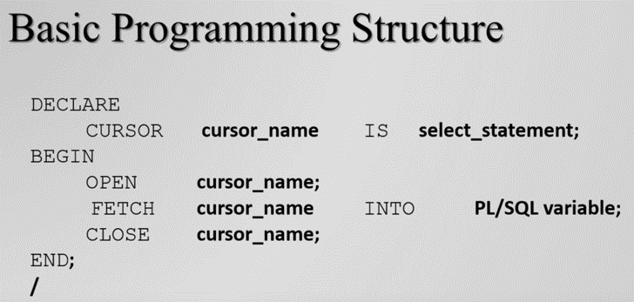
Explicit Cursors
Created explicitly by the developer using the DECLARE, OPEN, FETCH, and CLOSE statements.
Suitable for queries returning multiple rows.
Offers more control over the cursor's lifecycle.

Slide 24
Cursor Attributes
%FOUND
Returns TRUE if the cursor has fetched a row, FALSE otherwise.
%NOTFOUND
Returns TRUE if the cursor has not fetched a row, FALSE otherwise.
%ROWCOUNT
Returns the number of rows fetched so far by the cursor.
%ISOPEN
Always returns FALSE for implicit Cursors because oracle closes them automatically once the associated SQL statement is executed.

Slide 25
Creating an Explicit Cursor - DECLARE Statement
The DECLARE statement is used to define a cursor in the declaration section of a PL/SQL block or subprogram.
DECLARE
CURSOR cursor_name IS
SELECT column1, column2 FROM your_table WHERE your_condition;

Slide 26
OPEN Statement
The OPEN statement is used to execute the query associated with the cursor and make the result set available for fetching.
OPEN cursor_name;

Slide 27
FETCH Statement
The FETCH statement is used to retrieve rows from the cursor result set and assign them to variables.
FETCH cursor_name INTO variable1, variable2;
Fetch Options
NEXT: Retrieves the next row.
PRIOR: Retrieves the row before the current row.
FIRST: Retrieves the first row.
LAST: Retrieves the last row.
ABSOLUTE n: Retrieves the nth row.
RELATIVE n: Retrieves the row n positions from the current position.

Slide 28
Using Fetch Operations
FETCH cursor_name NEXT INTO variable1, variable2;
FETCH cursor_name PRIOR INTO variable1, variable2;
FETCH cursor_name FIRST INTO variable1, variable2;
FETCH cursor_name LAST INTO variable1, variable2;
FETCH cursor_name ABSOLUTE n INTO variable1, variable2;
FETCH cursor_name RELATIVE n INTO variable1, variable2;

Slide 29
CLOSE Statement:
The CLOSE statement is used to release the resources associated with a cursor once it is no longer needed.
CLOSE cursor_name;

Slide 30
Cursor FOR Loop
The FOR IN LOOP simplifies cursor processing by implicitly opening, fetching, and closing the cursor. It simplifies the cursor syntax.
FOR record_variable IN cursor_name LOOP
-- Access fields using record_variable.column_name
-- Process the fetched data
END LOOP;

Slide 31
Cursor FOR Loop
Scope:
Inside FOR Loop
Cursor Index:
a pointer to Query work area.
Query work area is a memory region ( context area ) of cursor.

Slide 32
Cursor FOR Loop
DECLARE
CURSOR C IS
SELECT empid AS eid , empname AS ename FROM employee ;
BEGIN
FOR i IN C LOOP
dbms_output.put_line( 'NAME' || i.ename );
END LOOP;
END;
/

Slide 33
%ROWTYPE Attribute
If all of the columns in a table are retrieved in the order in which they are defined, the %ROWTYPE attribute can be used to define a record into which the FETCH statement will place the retrieved data.
Each field within the record can then be accessed using dot notation.
The following example shows a procedure with a record definition that uses %ROWTYPE.
This record is used as the target of the FETCH statement.

Slide 34
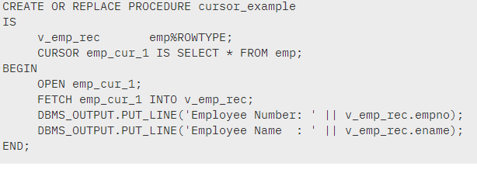

Slide 35
Example: Explicit Cursor
DECLARE
eid employee.empid%TYPE;
ename employee.empname%TYPE;
CURSOR cur IS
SELECT empid, empname FROM employee ;
BEGIN
OPEN cur ; LOOP
FETCH cur INTO eid , ename; EXIT WHEN cur%NOTFOUND;
dbms_output.put_line( 'NAME' || cur.ename ); END LOOP;
CLOSE cur ;
END;
/

